Slide 1




S.No. | Post | Name of the Student | Class | House
1. | HEAD BOY | RIYANSH | V E | JAWAHAR
2. | HEAD GIRL | ANICA ROHILLA | V E | SHASTRI
3. | VICE-HEAD BOY | YASHWIN YADAV | IV B | SUBHASH
4. | VICE-HEAD GIRL | TAANI JAIN | IV C | SUBHASH
5. | SPORTS SECRETARY (B) | VIRAJ DABAS | V D | JAWAHAR
6. | SPORTS SECRETARY (G) | OORJA GAAT | V E | TAGORE
7. | LITERARY SECRETARY | JIANA LAMBA | V A | SHASTRI
8. | CHIEF LANGUAGE PREFECT | MANAN SURI | V B | TAGORE
9. | CULTURAL SECRETARY | AMAYRA CHAWLA | V C | JAWAHAR
2025-26
A
bility…Motivation…
Attitu
de…

Slide 2



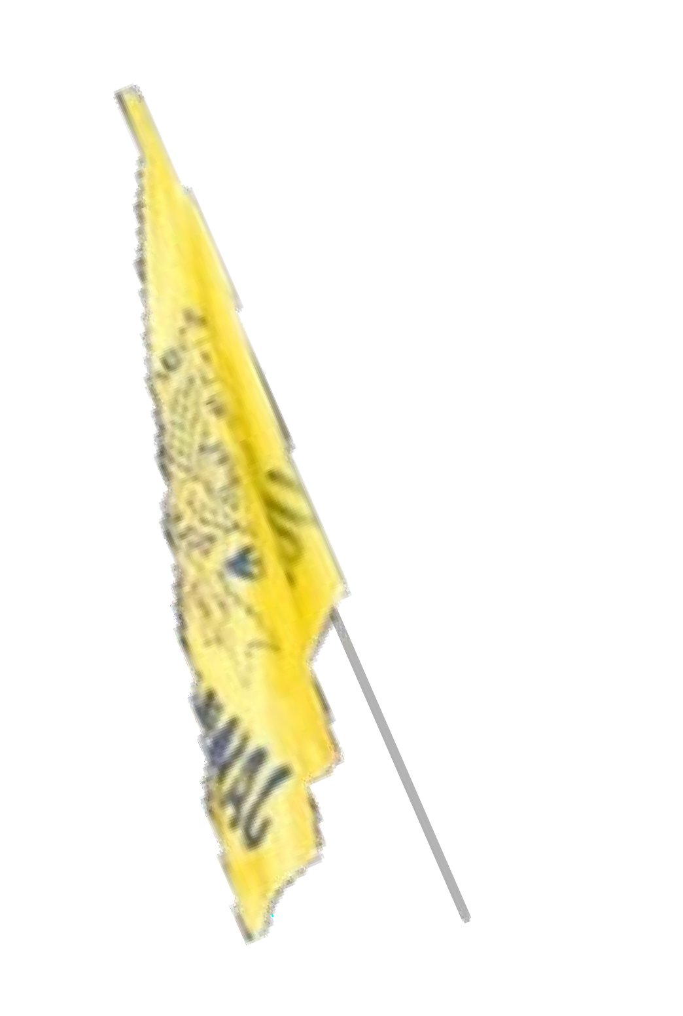

2025-26
S.No. | POST | NAME OF THE STUDENT | CLASS
1. | HOUSE CAPTAIN | SEHAJ KAUR | V A
2. | HOUSE VICE CAPTAIN | KANAK KHARI | IV C
3. | SPORTS CAPTAIN | PANSHUL | V D
4. | ENVIRONMENT BEAUTIFICATION PREFECT | PAVANI GOEL | V A
5. | HOUSE PREFECT | NUPUR AGGARWAL ARADHYA SETHI DRISHTI ARYAN GANDHI | V D V B V A V D
JAWAHAR HOUSE
S.No. | POST | NAME OF THE STUDENT | CLASS
1. | HOUSE CAPTAIN | VIKRAM CHAUDHARY | V C
2. | HOUSE VICE CAPTAIN | HARSHDEEP SINGH | IV C
3. | SPORTS CAPTAIN | YUG KUMAR | V E
4. | ENVIRONMENT BEAUTIFICATION PREFECT | DARVISH | V A
5. | HOUSE PREFECT | PRANIT LOHCHAB VANYA SHARMA PARINEET KAUR RIDHAM BINDAL | V C V E V E IV D

Slide 3
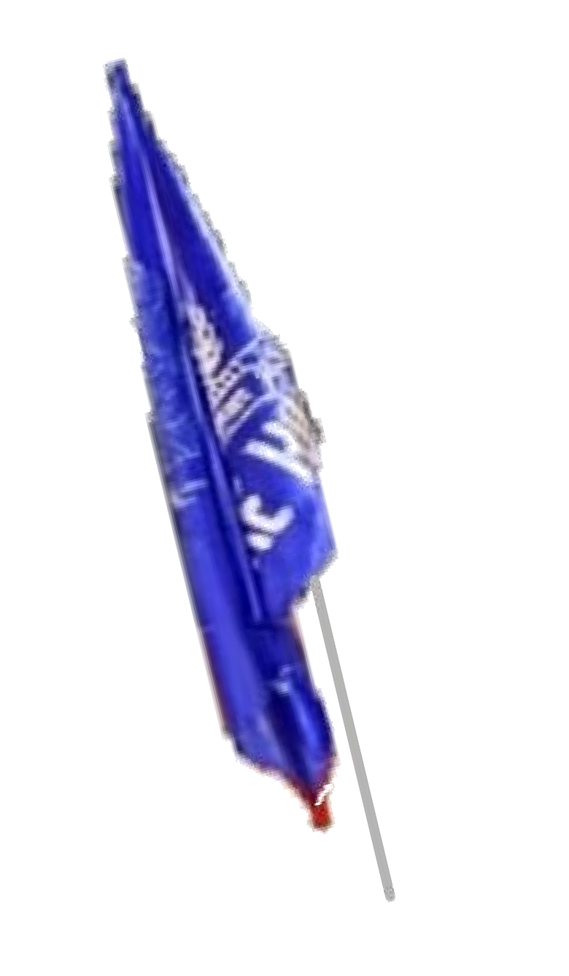


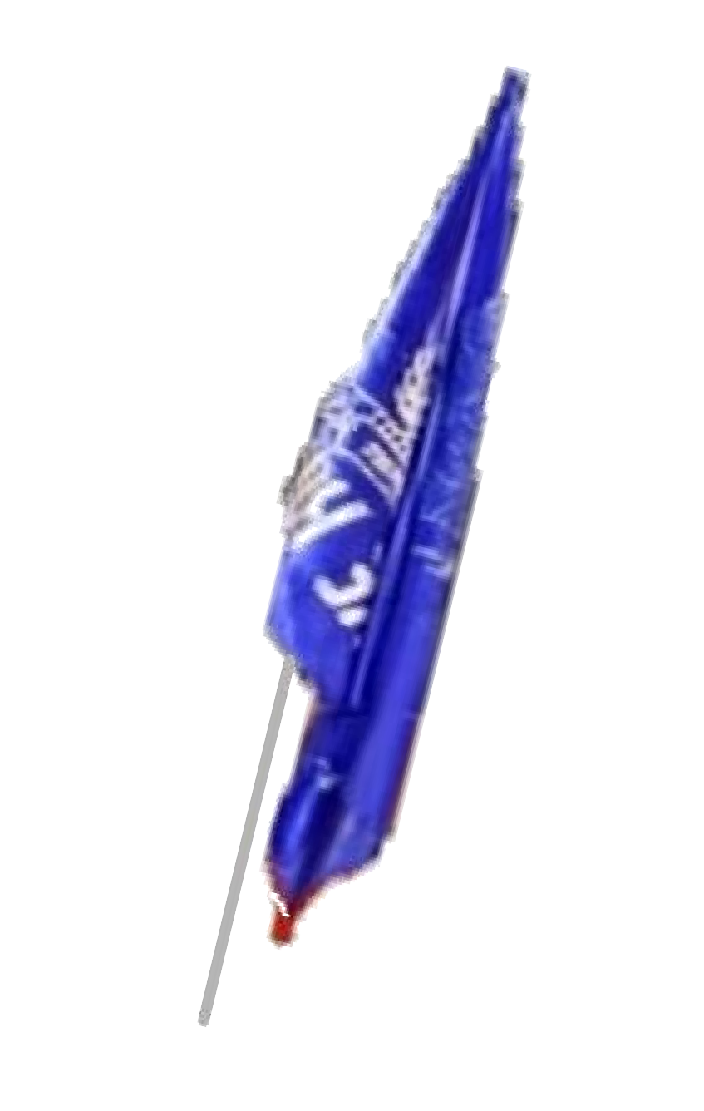
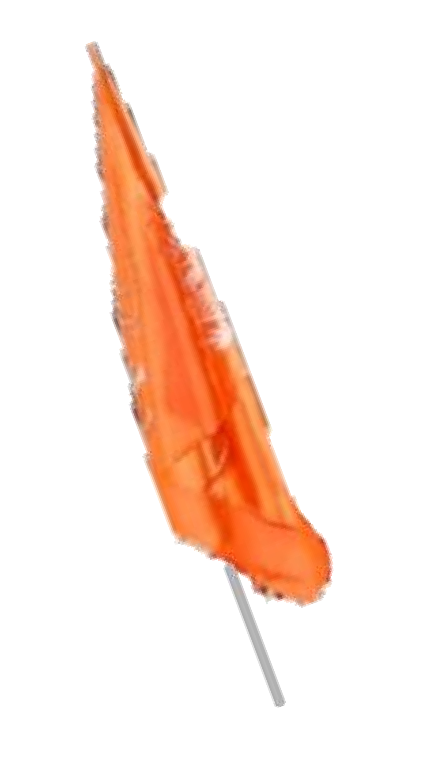


2025-26
S.No. | POST | NAME OF THE STUDENT | CLASS
1. | HOUSE CAPTAIN | MEDHANSH MITTAL | V B
2. | HOUSE VICE CAPTAIN | KANAV DHASMANA | IV A
3. | SPORTS CAPTAIN | AKSHAT | V D
4. | ENVIRONMENT BEAUTIFICATION PREFECT | MYRA NAGPAL | V D
5. | HOUSE PREFECT | YUKTI PRABHNOOR DHARV MAGGO PARIDHI | IV C V E IV D V B
S.No. | POST | NAME OF THE STUDENT | CLASS
1. | HOUSE CAPTAIN | HARIPRIYA TIWARI | V A
2. | HOUSE VICE CAPTAIN | HIVARSH VASHISHT | IV E
3. | SPORTS CAPTAIN | GIANSH BEDI | V C
4. | ENVIRONMENT BEAUTIFICATION PREFECT | RUHI VERMA | V D
5. | HOUSE PREFECT | ANAMIKA GUPTA SHRIKIRTI GUPTA DHARVIK LAXMI | IV A V A V A IV B

Slide 4






2025-26
S.No. | POST | NAME OF THE STUDENT | C LASS
1. | HOUSE CAPTAIN | DHAANI MAHAWAR | V A
2. | HOUSE VICE CAPTAIN | KIARA GUPTA | IV D
3. | SPORTS CAPTAIN | KANISHK | V D
4. | ENVIRONMENT BEAUTIFICATION PREFECT | AANYA MANGLA | V D
5. | HOUSE PREFECT | NISHTHA NIVI RANA DITYA AANYA PANCHANDA | V E V E V D V C
S.No. | POST | NAME OF THE ST U DENT | C LASS
1. | HOUSE CAPTAIN | AVIRAL SHARMA | V E
2. | HOUSE VICE CAPTAIN | FALAK | IV A
3. | SPORTS CAPTAIN | KAYAAN MALIK | V C
4. | ENVIRONMENT BEAUTIFICATION PREFECT | NYRA CHAUHAN | V C
5. | HOUSE PREFECT | SHAURYA GUPTA RAAVI SAXENA DAIVIK GOEL MANTRA | V B V E V B V E

