Slide 1
S.No. | Post | Name of the Student | Class | House
1. | HEAD BOY | VANSH DABAS | XII A | JAWAHAR
2. | HEAD GIRL | MOLLY NAYAR | XII C | SUBHASH
3. | VICE-HEAD BOY | ARCHIT VIJ | XI A | TAGORE
4. | VICE-HEAD GIRL | ARPITA SHOKEEN | XI A | GANDHI
5. | SPORTS SECRETARY (B) | SURYANSH KUNDRA | XII B | TAGORE
6. | SPORTS SECRETARY (G) | PARUL SHARMA | XI B | JAWAHAR
7. | LITERARY SECRETARY | BHAVIKA JAIN | XII A | PATEL
8. | CHIEF LANGUAGE PREFECT | AMOGH GIROTI | XI A | SHASTRI
9. | CULTURAL SECRETARY | HARSHIT | XI C | SHASTRI
2023-24
A
bility…Motivation…
Attitu
de…

Slide 2
2023-24
S.No. | POST | NAME OF THE STUDENT | CLASS
1. | HOUSE CAPTAIN | PRASHANSA YADAV | XII A
2. | HOUSE VICE CAPTAIN | TEJASVI ARYA | XI A
3. | SPORTS CAPTAIN | YATHARTH DUTT | X D
4. | HOUSE PREFECT | SAMANYU MITTAL AAHANA KHOSLA JAHNAVI JOSHI KAVYANSH PALIWAL | IX E IX E IX E X C
S.No. | POST | NAME OF THE STUDENT | CLASS
1. | HOUSE CAPTAIN | ADVIK DANG | XI A
2. | HOUSE VICE CAPTAIN | HARSHITA KHOLIYA | X A
3. | SPORTS CAPTAIN | BHAVYA SETHI | XII F
4. | HOUSE PREFECT | TVISHA LAMBA PRANAY JAIN APEKSHA KHURANA AARAV GARG | VIIIC IX E IX B IX E

Slide 3
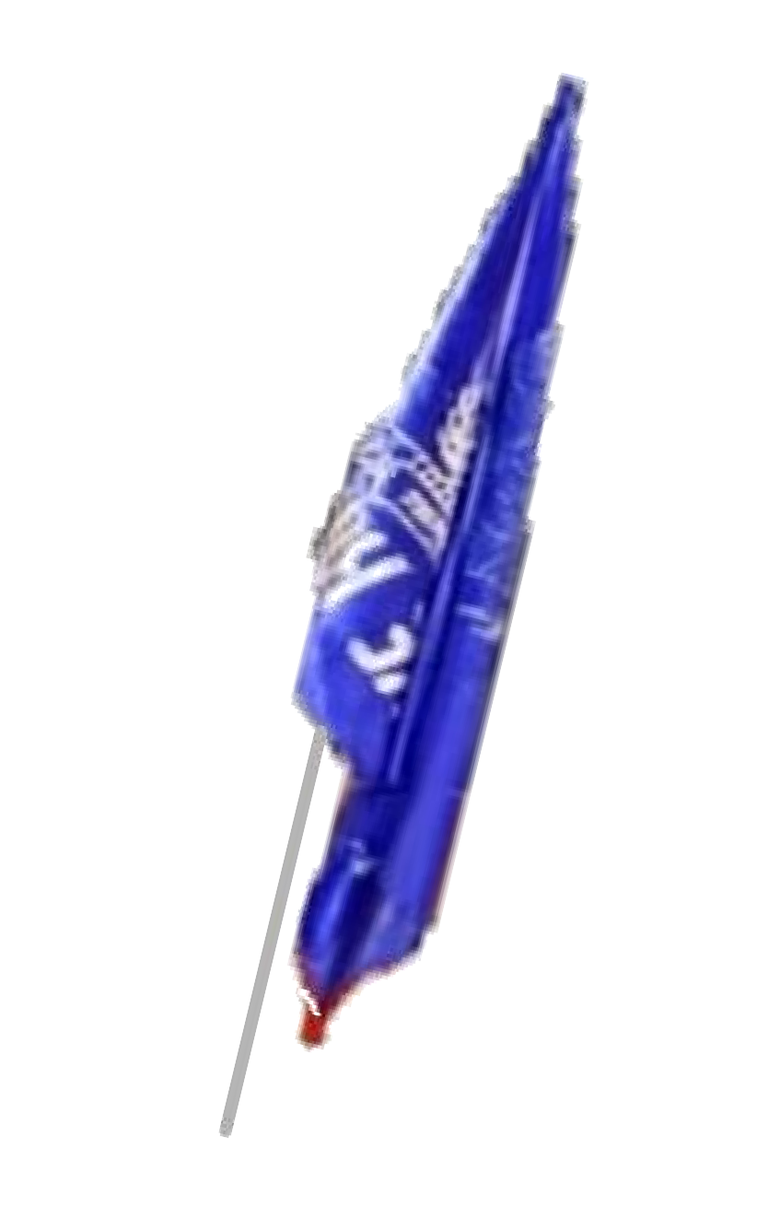
2023-24
S.No. | POST | NAME OF THE STUDENT | CLASS
1. | HOUSE CAPTAIN | MADHAV ASDRI | X C
2. | HOUSE VICE CAPTAIN | PRIYANSHI GUPTA | X C
3. | SPORTS CAPTAIN | BHUMIKA RAJESH DAHIYA | XII A
4. | HOUSE PREFECT | TANISHQ MALHOTRA NAISHA ASHMI GOYAL SIMRAN THAPAR | X C VIII B IX E IX E
S.No. | POST | NAME OF THE STUDENT | CLASS
1. | HOUSE CAPTAIN | NETANYA DUA | X C
2. | HOUSE VICE CAPTAIN | RITIKA KWATRA | X D
3. | SPORTS CAPTAIN | ROBINDEEP SINGH CHANNA | XI B
4. | HOUSE PREFECT | SOUMYA BANSAL HARGUN KAUR ADITYA JHA JHANAK BHALLA | X B IX E X A VIII C

Slide 4
2023-24
S.No. | POST | NAME OF THE STUDENT | C LASS
1. | HOUSE CAPTAIN | SHABD ARORA | XI F
2. | HOUSE VICE CAPTAIN | APARNA GUPTA | XI A
3. | SPORTS CAPTAIN | AADIL ABROL | XII A
4. | HOUSE PREFECT | YATHARTH YADAV ANAY SAMARIA MAHI NIYATI CHHABRA | XI A IX E IX A X C
S.No. | POST | NAME OF THE ST U DENT | C LASS
1. | HOUSE CAPTAIN | VANSH MAHAJAN | XI A
2. | HOUSE VICE CAPTAIN | SHIKHER MEHRA | XI F
3. | SPORTS CAPTAIN | GAURANG SETHI | XI D
4. | HOUSE PREFECT | DEYAN GUPTA VAANYA GOEL RIHAN DHAKA SOMYA SHARMA | X B IX E IX D IX D

